Slide 1
KVStore Roadmap (2)
Hao Liu
Nov 3,2016

Slide 2
Source structure and process
Functional module | Source code | Process
NVM persistent memory area reserve | nvmmap.c | 1. Rely on 4.2+ kernel version; 2. Modify the grub file, reserve a fixed-size memory area, this area is considered as PM by kernel; 3. Map the KVStore address space to reserved area and can read/write the memory content successfully.
Cuckoo hash table in DRAM | cuckoo.c cuckoo.h | 1. Complete the related data structure definition; 2. Complete all basic functions
City hash function | city.c city.h | 1. Reused the cityhash source code by google; 2. Used a test case to check the correctness of the source code.
System head files | kv.h common.h | 1. Define some global variables in KVStore, and will be extended during the following development;

Slide 3
Source structure and process
Functional module | Source code | Process
Some basic functions | util.c util.h | 1. Define some macros and fundamental functions, such as memcpy.
System format in NVM | super.c | 1. Define the structure of superblock, next will fill the format function.
log system | log.c log.h log.conf | 1. log system, output the system debugging info during the 2.
linear hash in NVM | linearhash.c linearhash.h | 1. linear hash table in NVM; 2. Dynamic split algorithm; 3. Hash table resize.

Slide 4
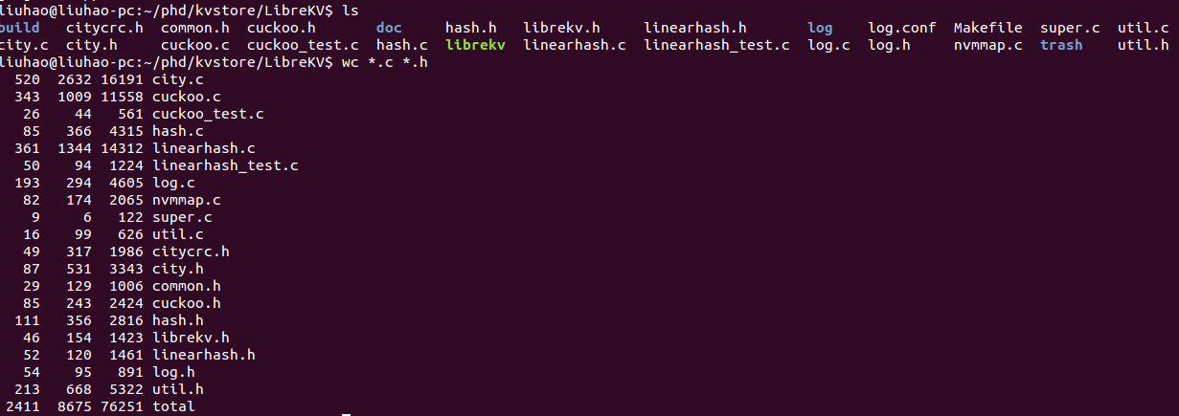
Source status
1. Compilable & Executable
2. 2411 LoC

Slide 5
Plan of next week
1. Merge thread between cuckoo hash and linear hash;
2. Joint debugging.

Slide 6
Open issues
1. Linear Hash function testing..
2. Hash Table resize in difficult.

Slide 7
Thanks!

